Slide 1
Stanisław Wyspiański
Polish writer and visual artist.

Slide 2
Date of birth
Stanisław Wyspiański was born on January 15, 1869 in Krakow. He was the son of the famous sculptor Franciszek Wyspiański and Maria née Rogowska. Wyspiański's birthplace is a house on a street Krupnicza 14 in Krakow (currently 26).

Slide 3
Stanisław Wyspiański live story.
In 1873, Stanisław Wyspiański with his parents moves from Krupnicza Street to the so-called Home Długosza at 13 Kanonicza Street. Stanisław's father sets up his studio here sculptural. In 1900, Stanisław Wyspiański married Teodora Teofila Pytko, maid in my aunt's house Stankiewiczowa. In July 1906 he moved to the purchased one by himself a house in the village of Węgrzce.

Slide 4
End of his life
Stanisław Wyspiański died November 28, 1907 year in Krakow On December 2 was his funeral in the church St Mary's and submission coffins in the Crypt Of Merit on the Rock.

Slide 5
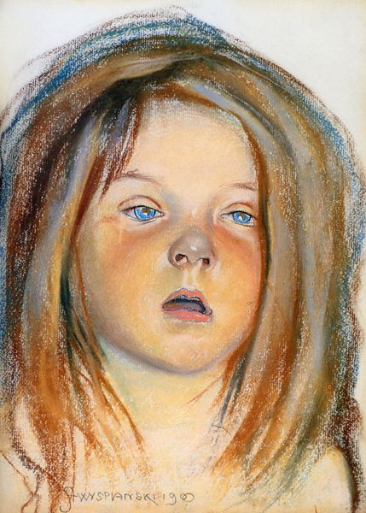
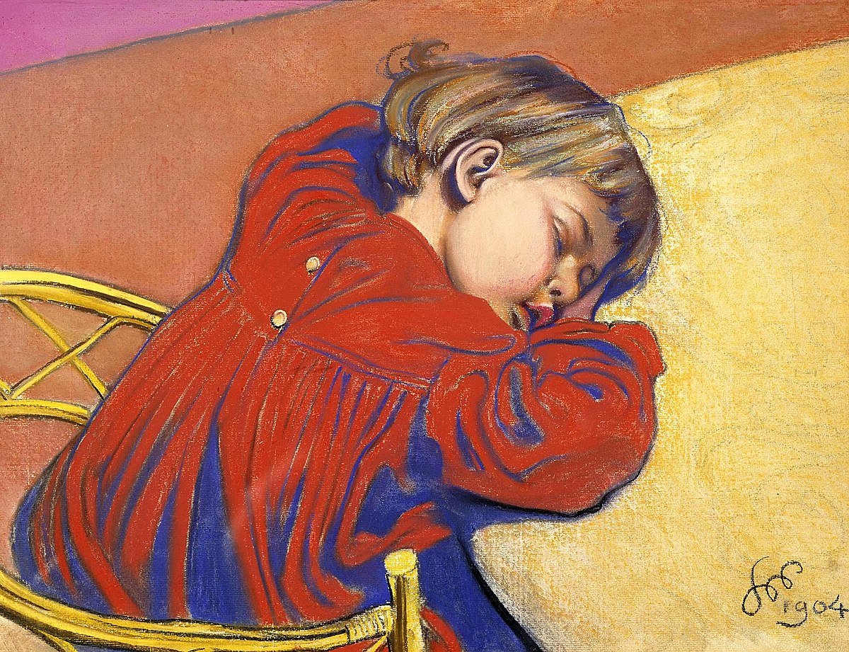
Stanisław Wyspiański - painter
Helenka, Staś sleep,

Slide 6
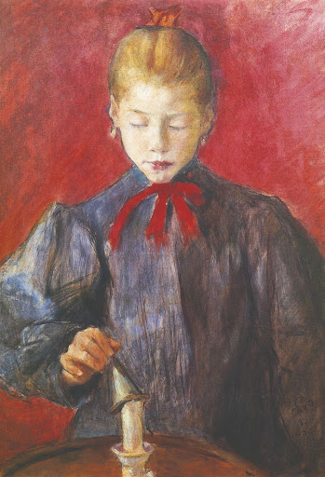
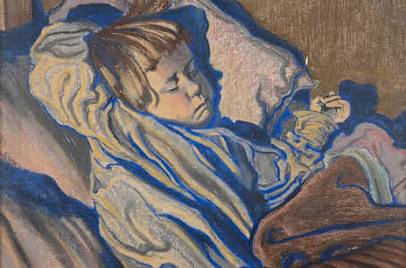
Stanisław Wyspiański- painter
Dziewczynka gasząca świecę Śpiący Mietek

