Slide 1
Sport ☺

Slide 2
Sport – volleyball game
My hobby is playing volleyball. I started playing this sport at the age of 6 and ended at the age of 12. I took part in many competitions and even the Polish championship.

Slide 3
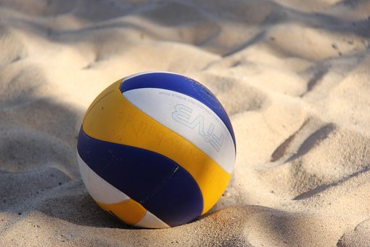
Volleyball - a team sport involving two teams of 6 players each (quarterback, attacker, two middle and two receiving, libero). However, there are only six players on the pitch, the libero swaps with the mid laner in the back line when the team takes the service. VOLLEYBALL CAN BE PLAYED BY WOMEN AND MEN

Slide 4
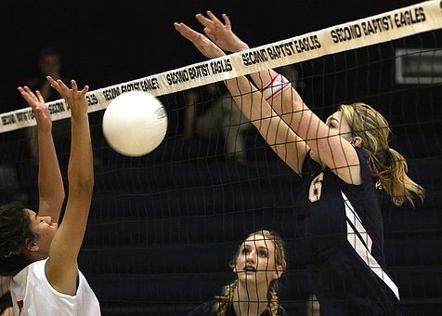
Rules: Volleyball consists in hitting the ball with any part of the body (most often with the hands) so that it goes over the net and touches the opponent's half of the pitch. Each team can make three bounces - pick up, display and attack - each next is a mistake. Points are earned in a number of ways, for example when the ball touches the opponent's half of the playing court or when it falls off the pitch and the opponent touched it last. The game continues until one of the teams wins 3 sets (in youth groups 2 - youths and youths) - in each of them the competition continues until they score 25 points with an advantage of at least two points. With the score of 24:24, the game is "ahead" until one of the teams has a two-point advantage over the other. The only exception is the fifth set, known as the "deciding set", which is played if the state of the match after 4 sets is 2: 2. In this set, players play up to 15 points, also with a lead of at least two points.

