Slide 1
Female Scientistis

Slide 2
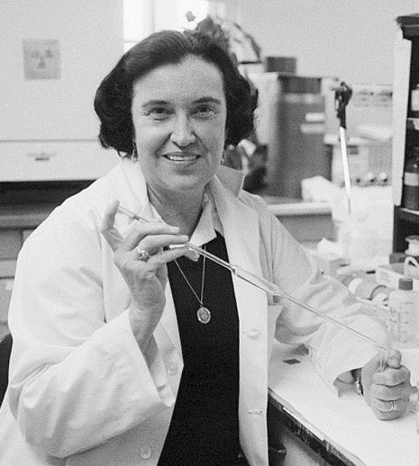
Rosalyn Yalow
Rosalyn was born in 1921 in Bronx. She and her partner developed technique for testing hormones (radioimmunology ). It involves the reaction of an antigen with an antibody. She was second women who got Nobel Prize in the field of physiology. Thanks to her, today we can find difference between type 1 diabetes and type 2 diabetes.

Slide 3
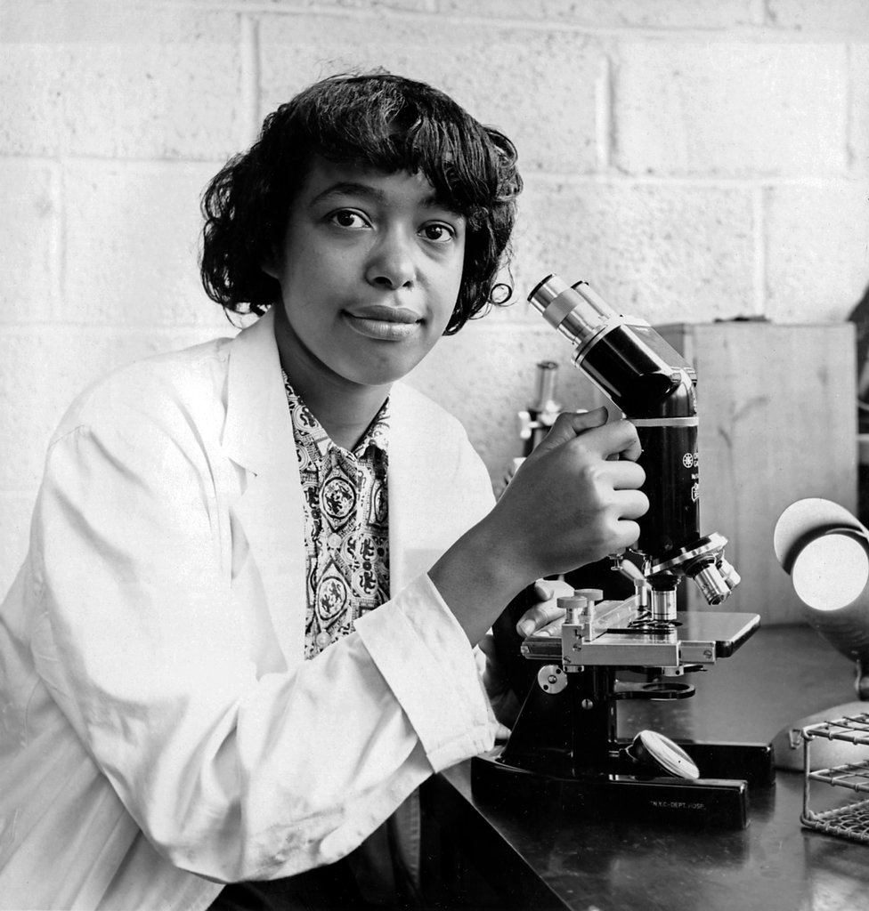
Patricia Bath
Patricia was born in 1942 in New York and she was working as a ophthalmologist. She invented a laser probe which helped in fight with cataract.

Slide 4
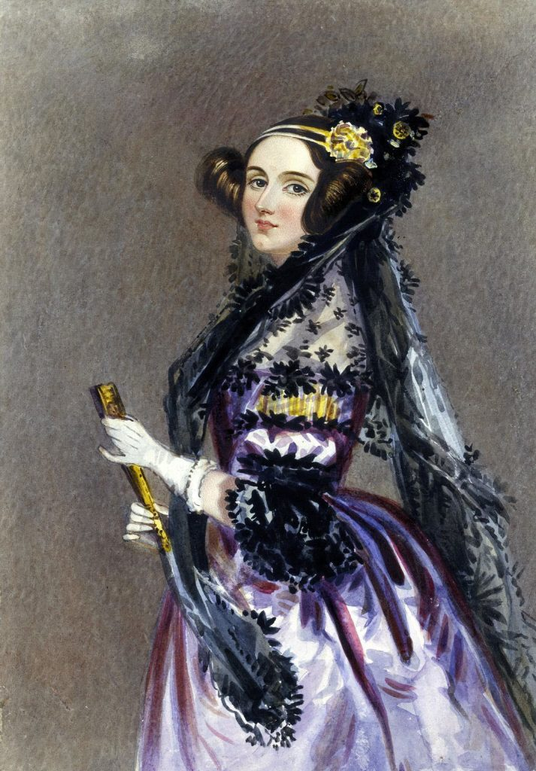
Ada Lovelace
Ada was born in 1815 in London. She published scheme about mechanical computer -Charles Babbage. Because of it she is considered as the first developer. Eventually, complete copy of machine never showed up.

Slide 5
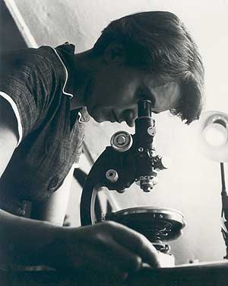
Rosalind Franklin
Rosalind was born in 1920 in London. She graduated from Cambridge University and she defended her doctorate in phisical chemistry. She is codiscoverd of the DNA dobule helix. In 1953 she focused on virus research. When she become 37 she got ovarian cancer and despite the disease she spent last weeks of her life in the laboratory.

Slide 6
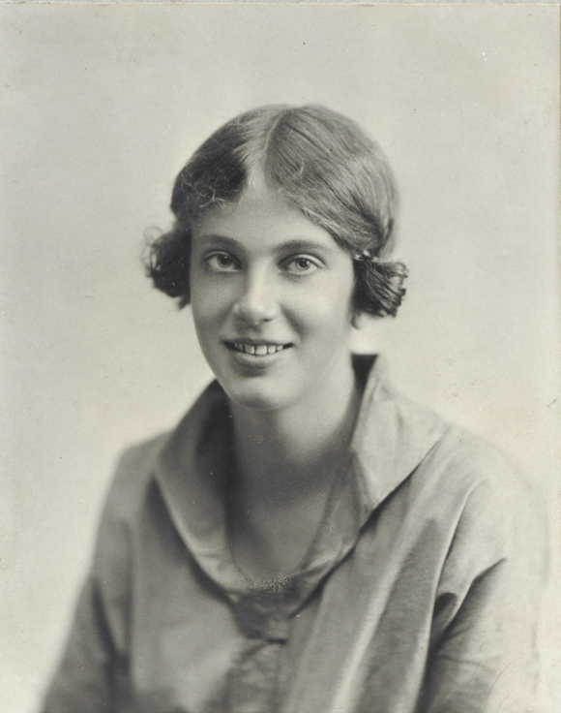
Dorothy Crowfoot Hodkin
Dorothy was born in 1910 in Cairo and she was the winner of the Nobel Prize in chemistry. She outlined structure penicillin and vitamin B12.

Slide 7
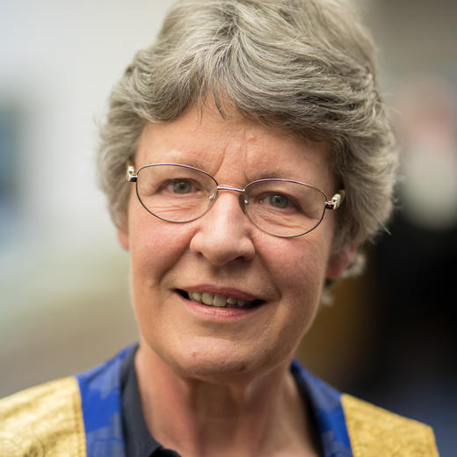
Jocelyn Bell Burnell
Jocelyn was born in 1943 in Belfast. She was working under the guidance of Antony Hewish. She was the first person who saw pulsary. In 1974 Antony won Nobel Prize and Jocelyn wasn’t awarded.

Slide 8
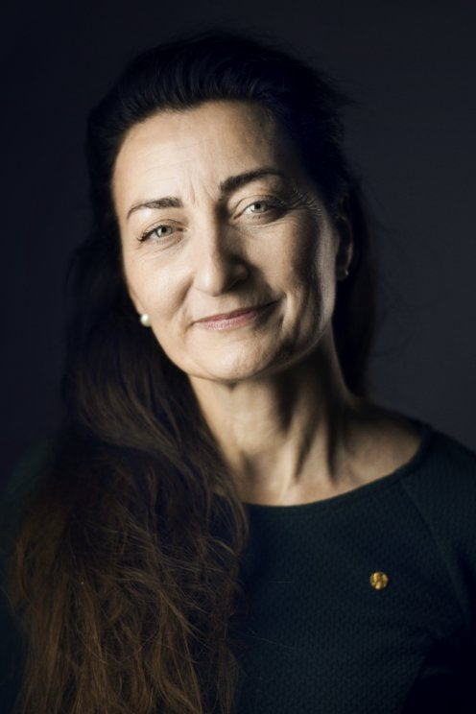
May-Britt Moser
May-Bitt was born in 1963 in Fosnavag. In 2014 She, her husband and John O’Keefe received the Nobel Prize because of discovery of the GPS of the brain.

Slide 9
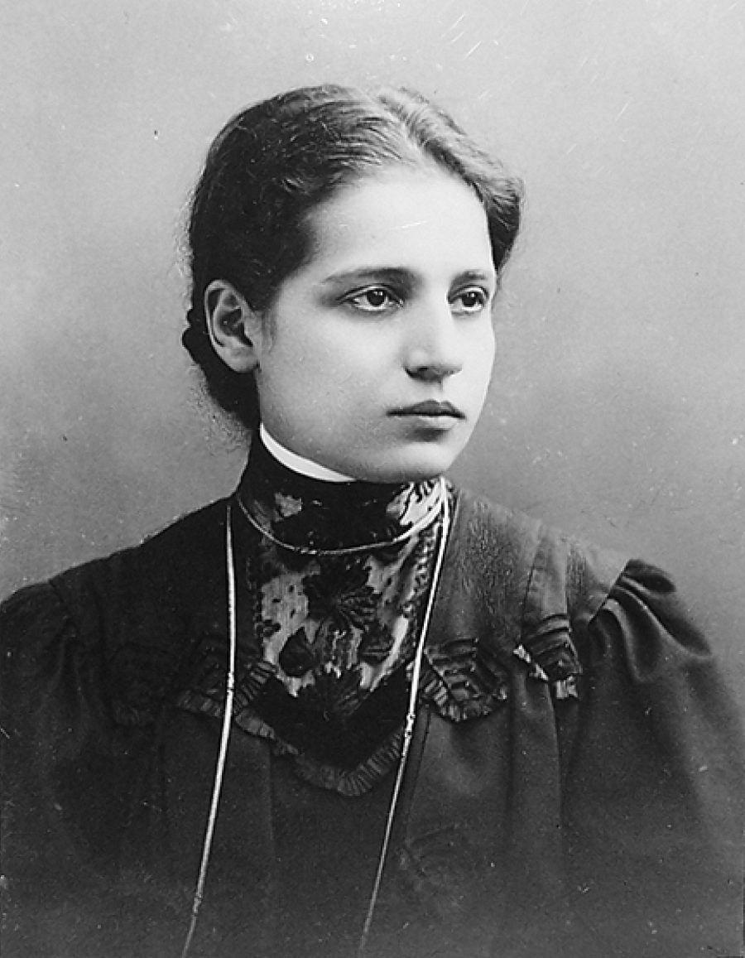
Lise Meitner
Lise was born in 1878 in Vienna. Together with Otto Frisch they discovered an explenation for the phenomenon of nuclear fission.

Slide 10
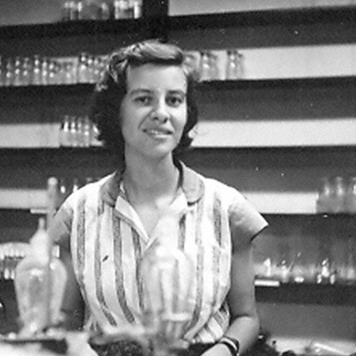
Esther Lederberg
Esther was born in 1922 in New York. She studied genetics in the Stanford University and she defended her doctorate in the Wisconsin University. She discovered the lambda phage which became as a model organism and cloning tool used in genetics.

