Slide 1
Team games
Inez Serwicka

Slide 2
Football
Football is a team game. There are 11 players in one team. in this game there are rules such as, you cannot foul, it means that you cannot put someone's foot or push someone. However, there are times when players commit a foul. There are also finals, Poland versus Germany. The match lasts 90 minutes, but the referee may add time. You can also get a red or a yellow card.

Slide 3
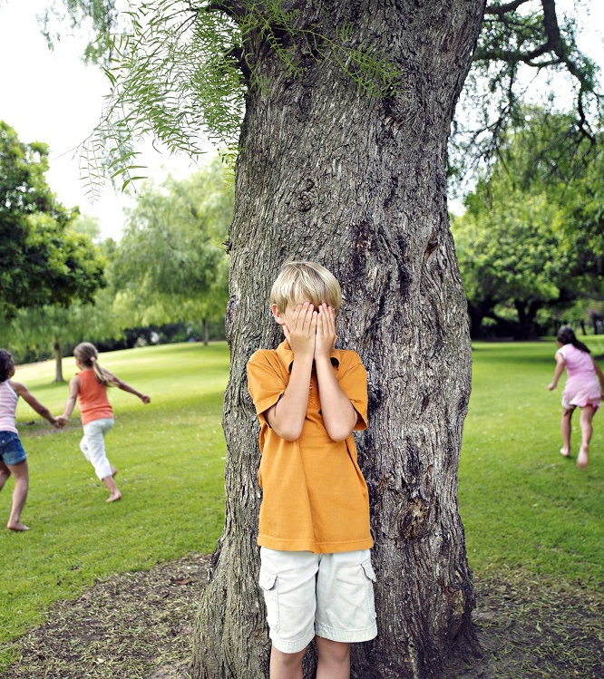
The game of hide and seek consists in the fact that 1 selected person leaves and counts to 10, and the rest of the players hide in different places. When the person stops counting, he calls: LOOKING FOR! and starts looking for who finds the first one in the next round is looking for. But the seeker may give up, he simply calls out, but he may also find everyone.

Slide 4
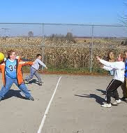
Very old and popular fun for children, but not only. All we need to play is a playground, gym or a piece of land on which we can easily set boundaries. A ball will also come in handy. It can be a soccer ball, a handball ball, or a volleyball ball. We divide our participants into two (preferably equal) groups. If the group knows each other, we can let them go on their own - for example, by indicating the captains who will decide the composition of the team themselves. See below for how this can be done. The teams face each other on the pitch. The captains, on the other hand, stand behind the opposing team.

