Slide 1
THE MATILDA EFFECT
and its victims

Slide 2
WHAT IS THE “MATILDA EFFECT”?
It is a term that describes cases of omitting the participation of female scientists in research work and attributing their achievements to male scientists.
Even at the beginning of the 20st century, it was believed there is certain mental disorder called anorexia scholastica, which only affected women and manifest itself, among others, in neurosis, sleepwalking, epilepsy, severe weight loss, or loss of morality. This disorder was a sign of too much education of the woman and it was believed that it was an incurable disease. It was a sign of clear discrimation against women.

Slide 3
The case of
ROSALIND FRANKLIN

Slide 4
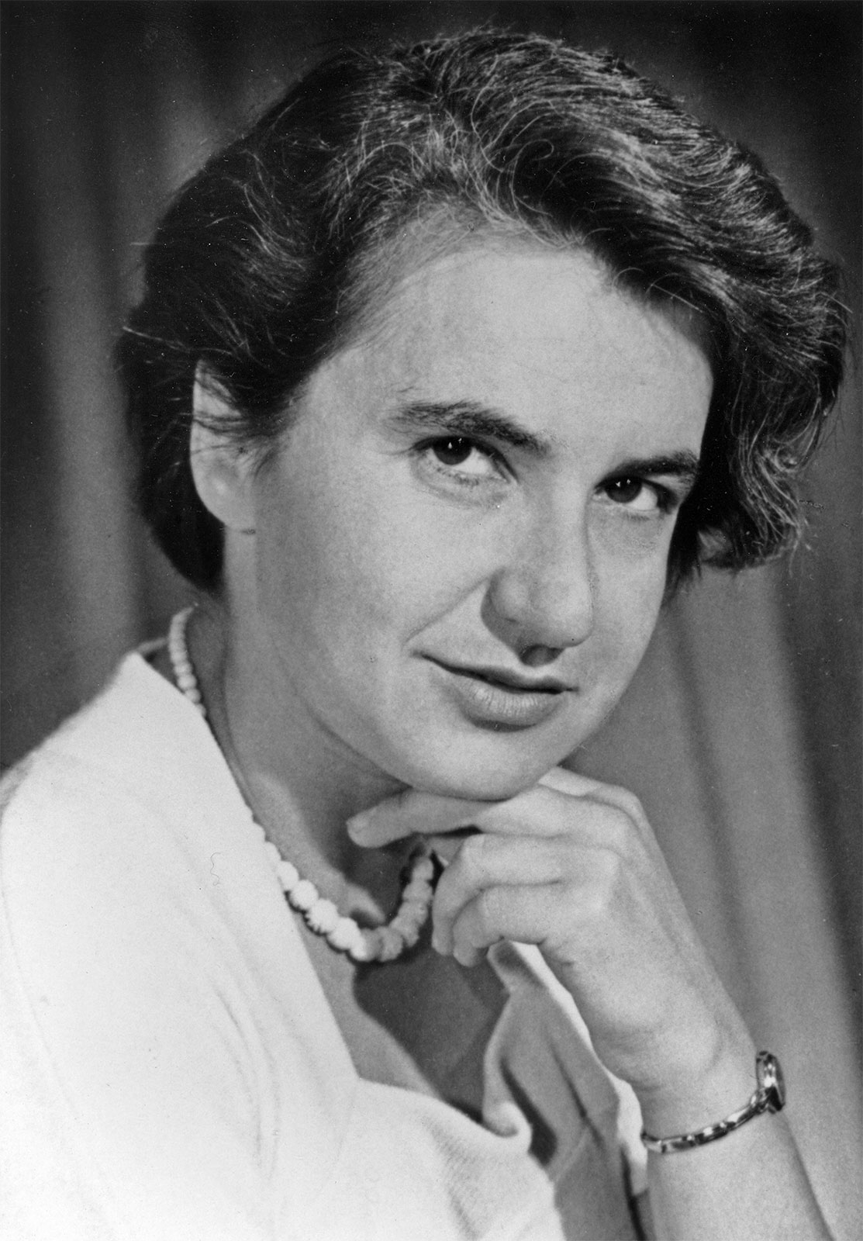
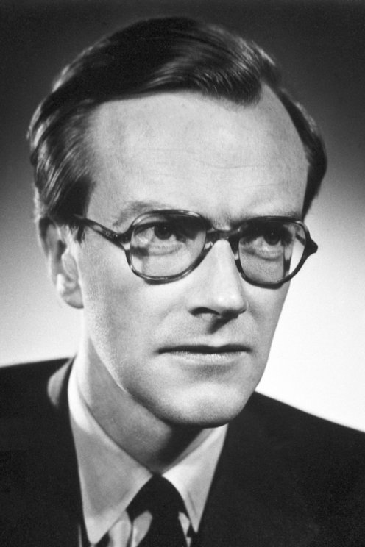
She was an English chemist and X-ray crystallographer. She become well known because of her work about structure of coal when she has been living in France.
In 1950, she returned to England to study protein structure at King's College (London), but the school has received very good DNA samples, so she and Maurice Wilkins began working on them together. At first, they did not know that they would be working together, which created a very tense atmosphere in the lab.
Maurice Wilkins

Slide 5
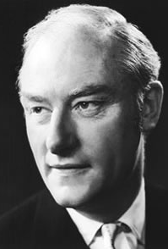
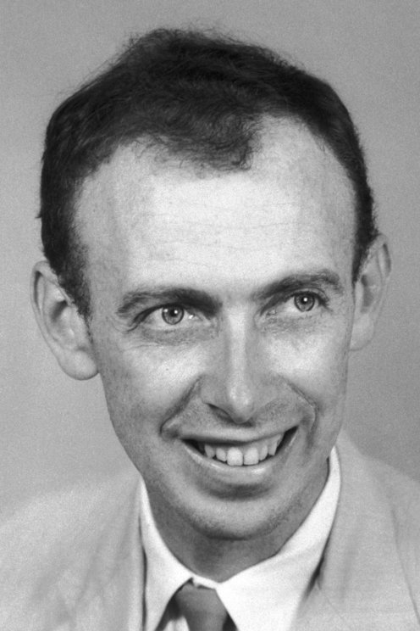
Francis Crick
At the same time, at the Cavendish Laboratory in Cambridge, two scientists, James Watson and Francis Crick, tried to guess the structure of DNA, but due to lack of appropriate skills, they were only unsuccessful guesses. Rosalind, thanks to her knowledge, would always found basic errors in their propositions.
James Watson

Slide 6
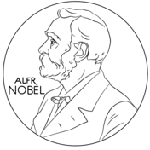
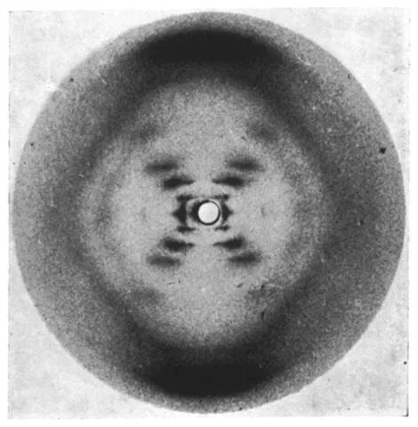
Meanwhile, her notes included her guesses about the helix structure and other details of the structure, which turned out to be true thanks to one of the photographs she took.
Unfortunately, without her knowledge, her collaborator Wilkins showed the woman's discovery to rival researchers, for which the three of them were awarded the Nobel Prize in 1962. In their speech, they did not mention a single word about Rosalind.
The photo she took

Slide 7
The case of
MARY WHITON CALKINS

Slide 8
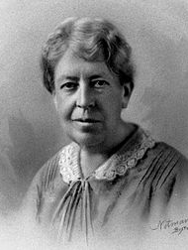
Initially she worked as a Greek teacher at Wellesley College for women, but soon devoted herself to psychology-she founded a psychological research laboratory at the college. While studying psychology at Harvard University, she collaborated with William James and Hugo Münsterberg to write a research paper on memory. She developed the memory technique of pairwise associations. She also developed her own philosophical doctrine.

Slide 9
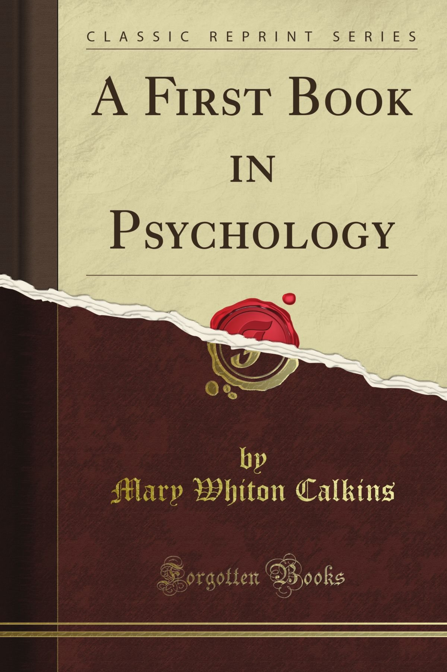
Harvard University refused to grant her a doctoral degree as a woman, and this despite her excellent exam score and the recommendations of scholars: William James and Josiah Royce. Radcliffe College intended to confer the degree on her, but she refused. However, she was elected president of the American Psychological Association in 1905 (as the first woman) and of the American Philosophical Association in 1918. She never received her doctoral degree.

Slide 10
The case of
CECILIA PAYNE-GAPOSCHKIN

Slide 11
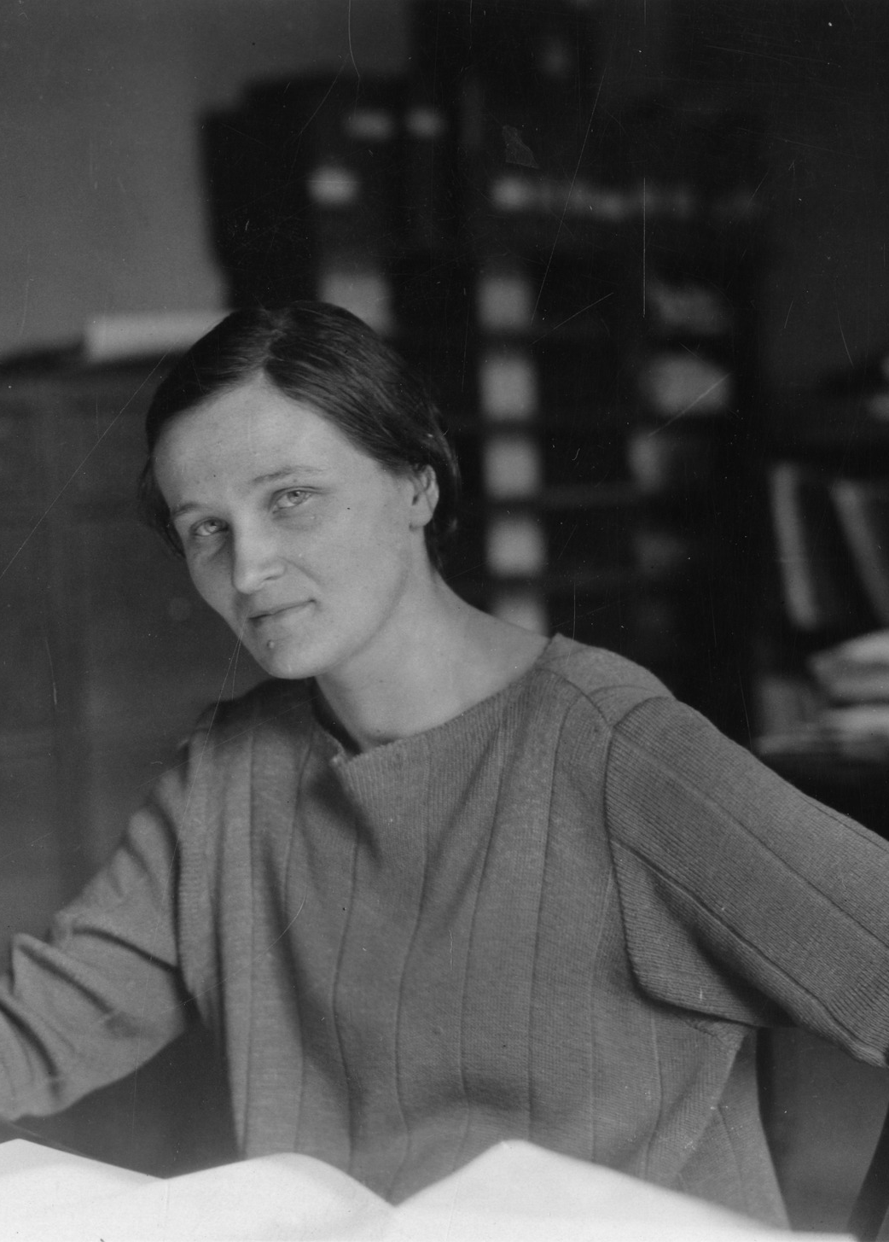
Cecilia was a British astronomer. She initially studied at the University of Cambridge in England and later became one of the first graduate students in astronomy at Harvard College Observatory in the United States. She was involved in the study of the spectra of stars.

Slide 12
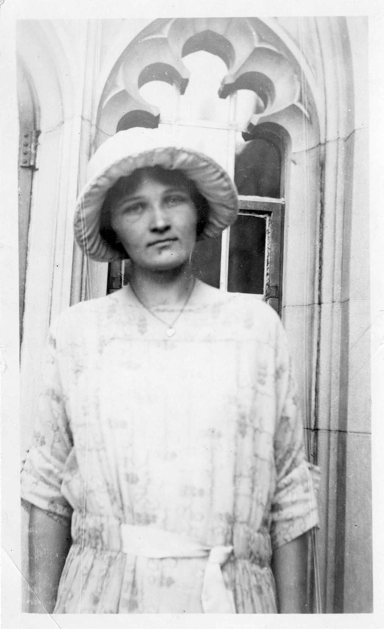
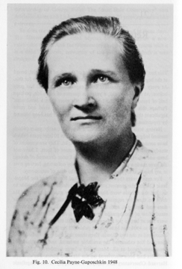
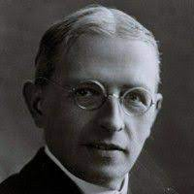
She discovered many facts about the structure of stars, including that hydrogen is the most common element in stars. These claims were rejected until 1929, when one of her previous opponents, Henry Norris Russell, published them. She was the first woman to become a professor at Harvard University.
Henry Norris Russell

Slide 13
PRESENT TIMES

Slide 14
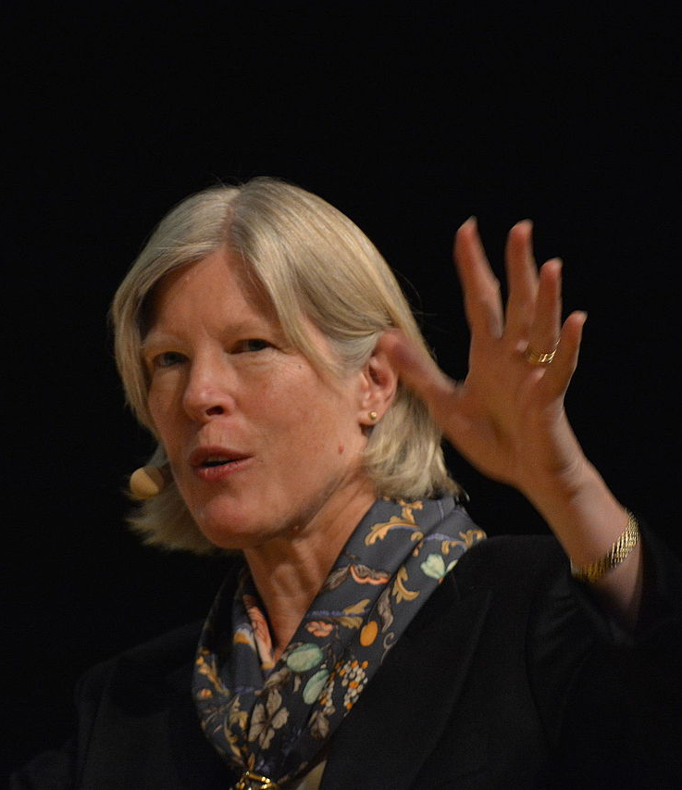
Cynthia Jane Kenyon is an American molecular biologist and biogerontologist known for her genetic dissection of ageing in a widely used model organism. Her genetic studies regarding ageing in C. elegans worms show us that it may be possible to make life longer. She found that a daf2 hormone receptor mutation doubled the lifespan of a simple worm without impacting on the quality of the worm’s life. In human terms, a mutant worm would look like a teenager in middle age.

Slide 15
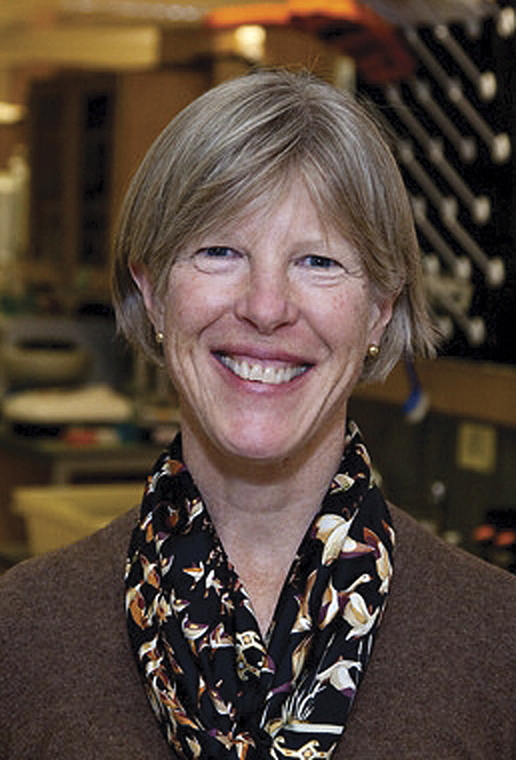
The most impressive part of Cynthia Kenyon’s studies is that when repeated on mice, the same effect took hold. As mice are mammals, it is possible that the same effect could be achieved in humans. Another finding was that living things with mutated daf2 hormone receptors are less likely to get ageing diseases, such as Alzheimer’s, cancer, or heart disease. This is big revolution in science!

Slide 16
Nina Marie Tandon is an American biomedical engineer. She is the CEO and co-founder of EpiBone, a company that grows bones for skeletal reconstruction. It allows practitioners to repair bone defects in people by using the patient’s stem cells to grow new healthy bones in a lab environment. They can be made to exact measurements to reflect the patient’s body. It also means that the patient’s immune system will naturally accept the new bone, rather than fighting against it.

Slide 17
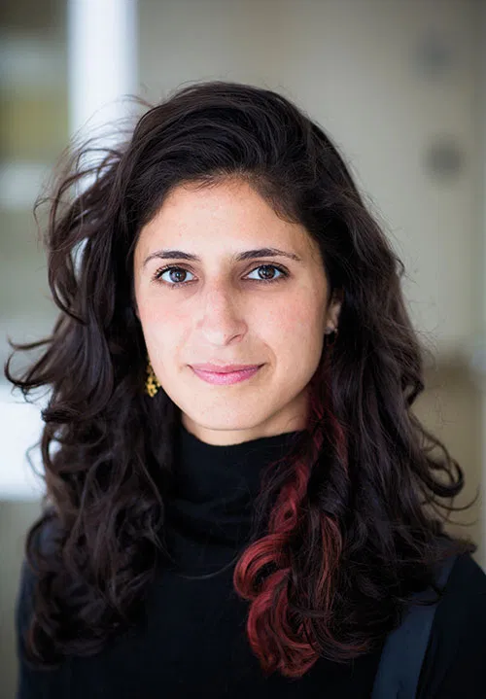
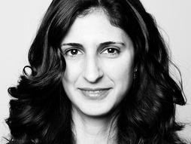
Amazingly, the bone can also grow, which means that for children with bone defects, their body can develop as usual. Currently, she has grown cells on rat hearts, to beat, but her ultimate goal is to have the ability to create a process where scientists can grow entire human organs. This could be significant point in human history.

Slide 18
The end
Wiktoria Zawierucha

