Slide 1
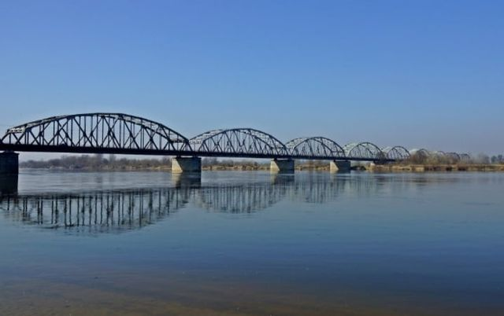
My city is Grudziadz

Slide 2
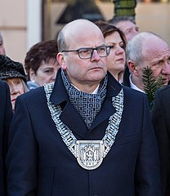
President of Grudziadz
The president of Grudziadz is Maciej Glamowski. He has been the president since 2018

Slide 3
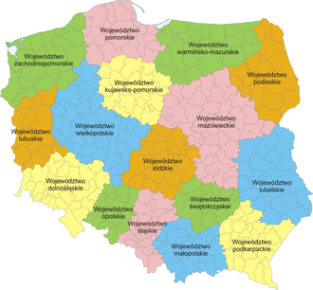
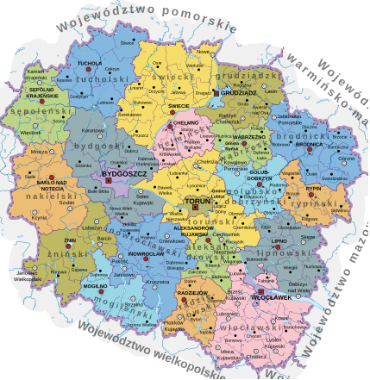
Map of the Kuzarian - Pomeranian poviat

Slide 4
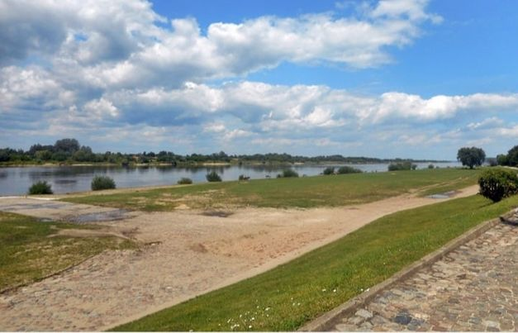
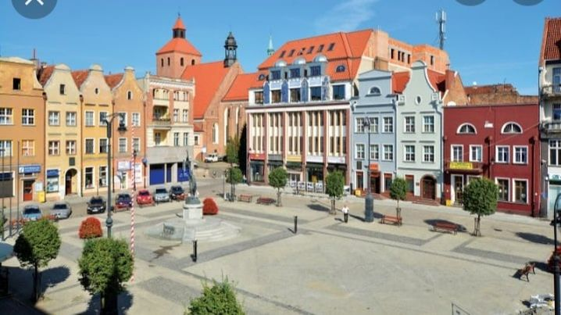
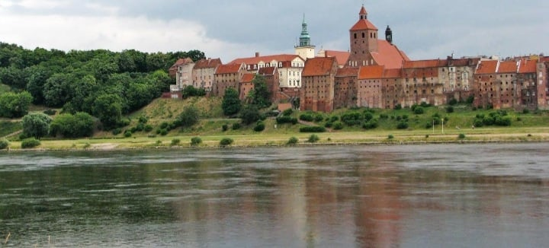
Grudizadz <3
Grudziadz is situated on the right bank of the Vistula River. Although Grudziadz is quite a small city, it hides many beautiful places and monuments.

Slide 5
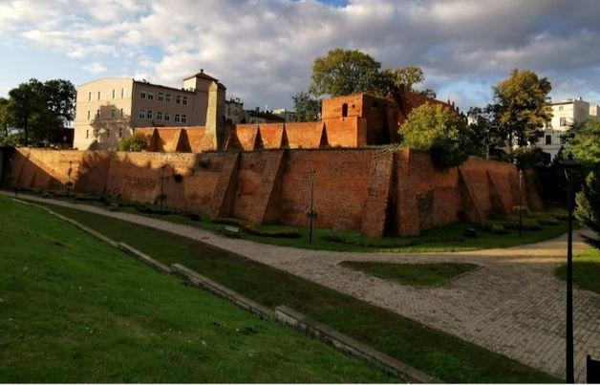
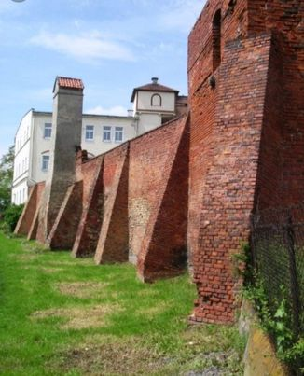
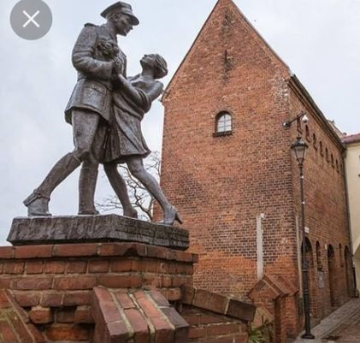
City walls from the 14 th/15 th century.

Slide 6
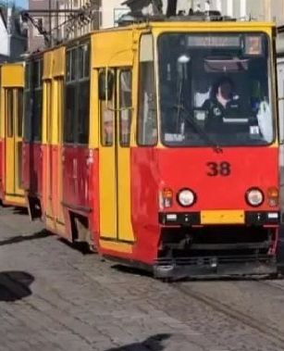
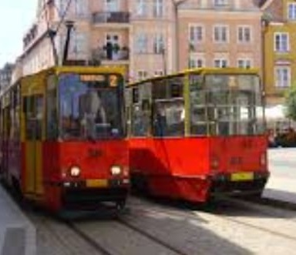
We also have old tram depot opened in 1896
trams <3

Slide 7
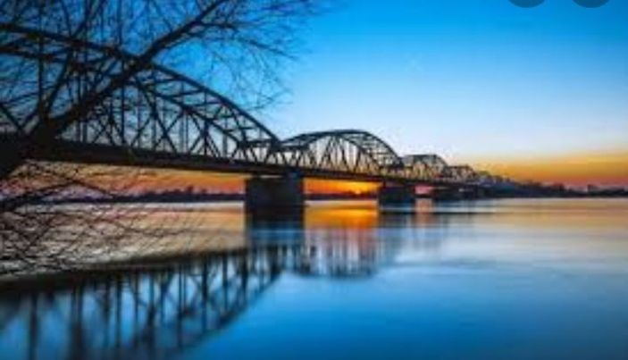
Grudziadz bridge
We also have a bridge named after Bronisław Malinowski, it is the longest road and railway bridge in Poland, which is located on the lower Vistula in Grudziadz and it measures 1098 meters.
It is named after the athlete Bronisław Malinowski who died in a road accident on September 27, 1981.

Slide 8
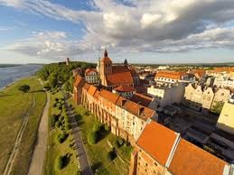
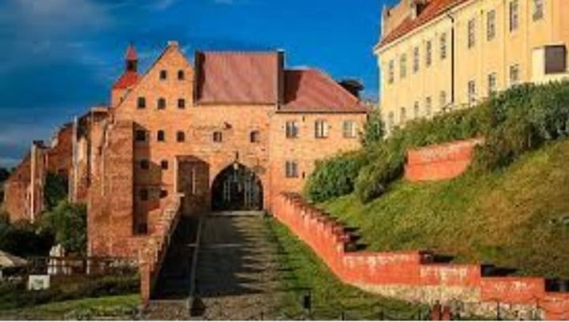
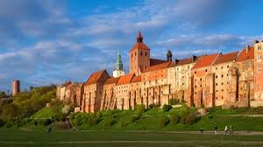
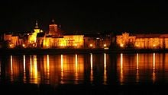
Historical monuments
The water gate and graniaries are on of the most recognizable.

Slide 9
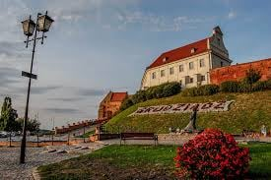
A picture is worth a thousand words
Despite the old buildings that can be visited on a daily basis, we can also boast beautiful parks, at the top Vistula Błonia and the castle hill at which there is one of the most recognizable monument, i.e. Klimek tower with an observation deck.

Slide 10
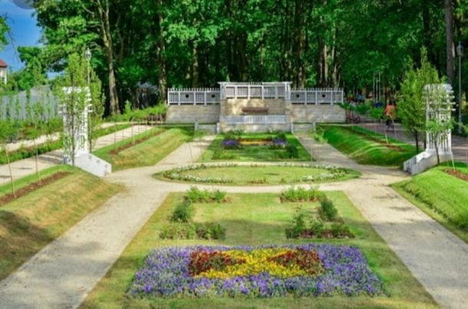
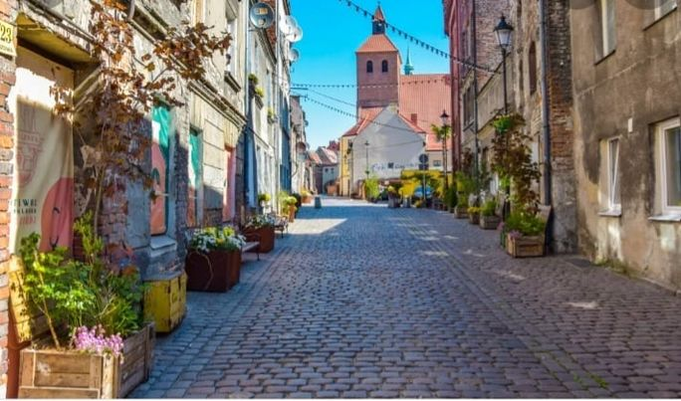
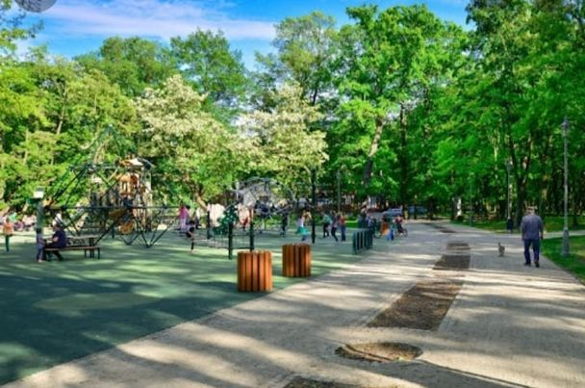
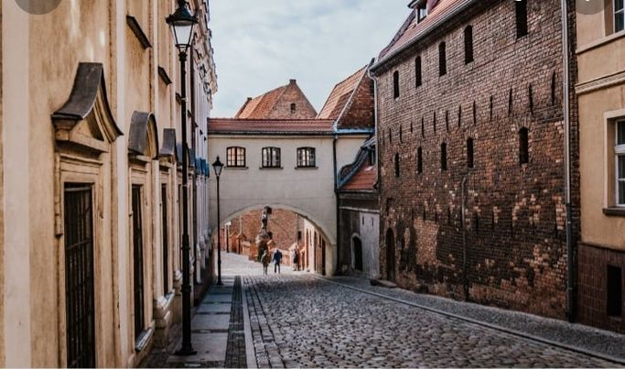
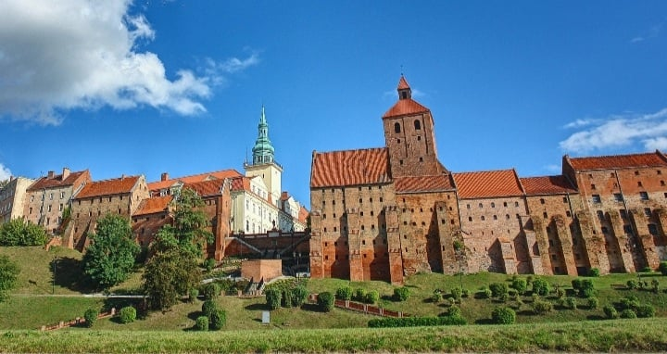
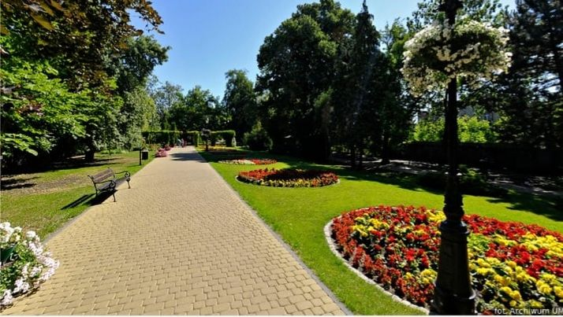
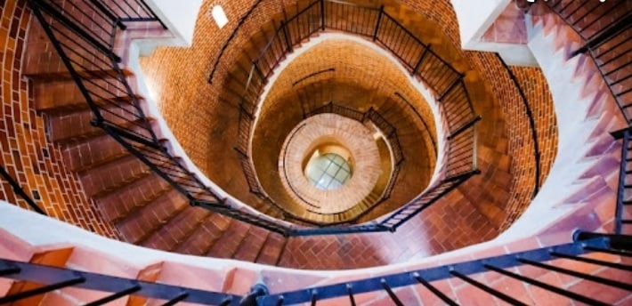
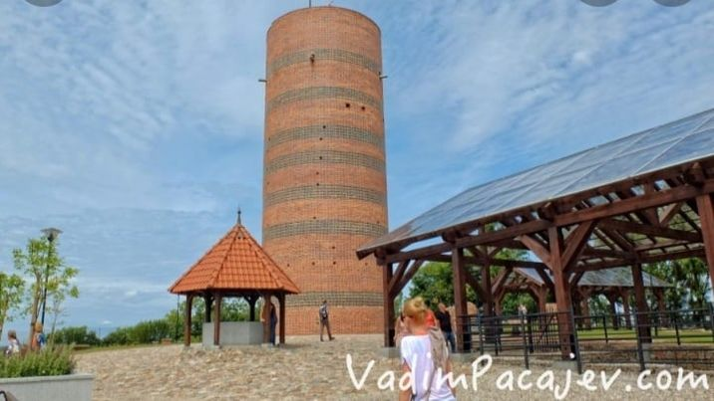
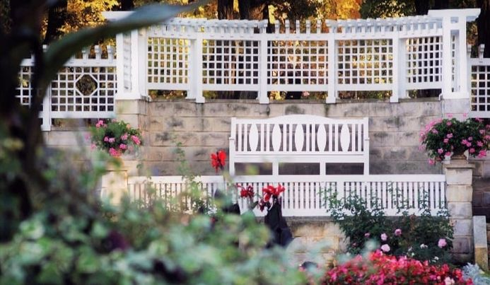
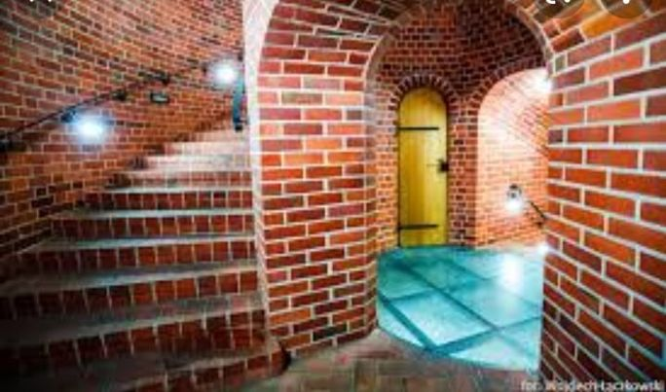
Vistula Błonia,parks, and the castle hill Klimek tower

Slide 11
And numerous remnants of the oldest monuments that can now be visited. Grudziadz is a really interesting city that hides a lot of secrets and stories.

